Slide 1
Deploy workloads with Azure Databricks Workflows

Slide 2
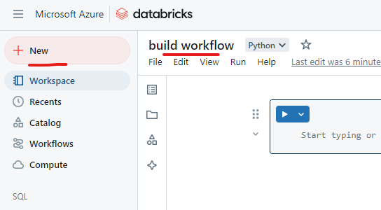

Slide 3
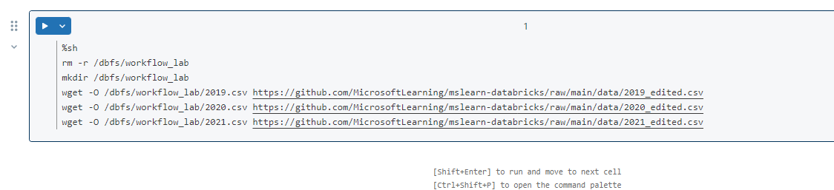
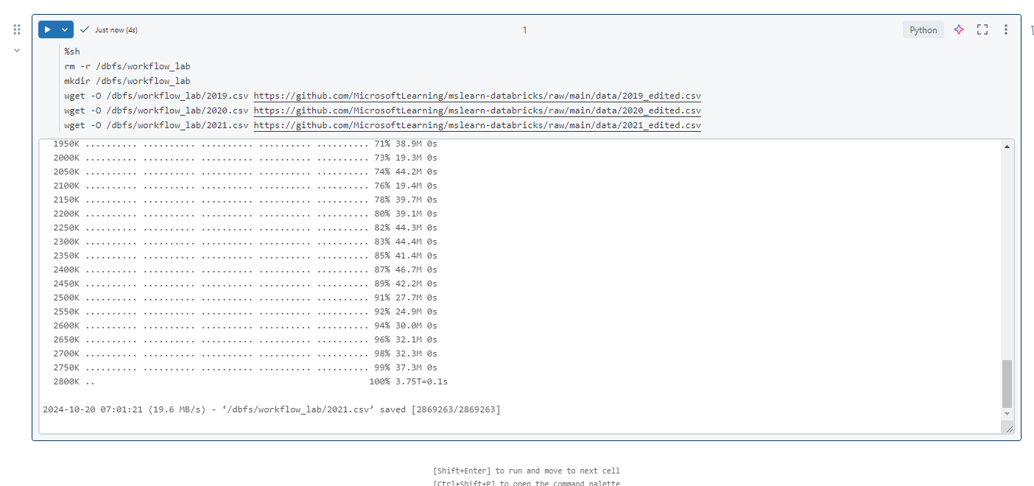

Slide 4
Create a job task
You implement your data processing and analysis workflow using tasks. A job is composed of one or more tasks. You can create job tasks that run notebooks, JARS, Delta Live Tables pipelines, or Python, Scala, Spark submit, and Java applications. In this exercise, you will create a task as a notebook that extracts, transforms, and loads data into visualization charts.

Slide 5
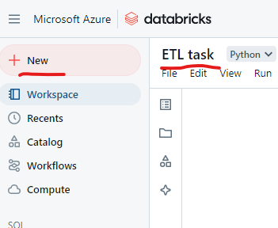

Slide 6
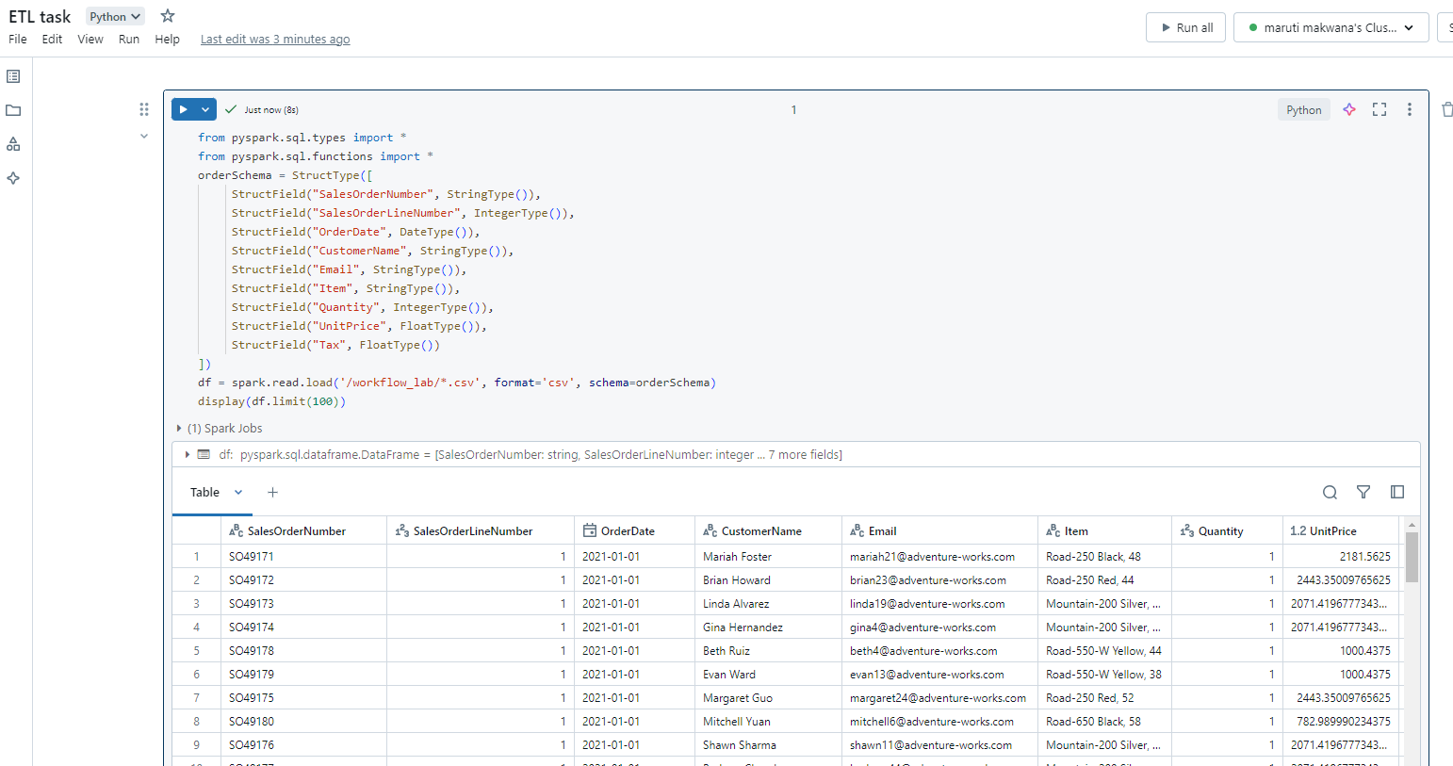

Slide 7
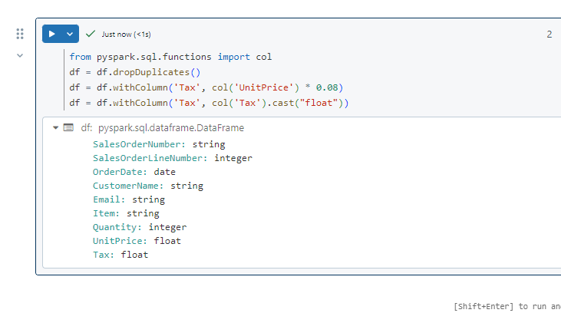

Slide 8
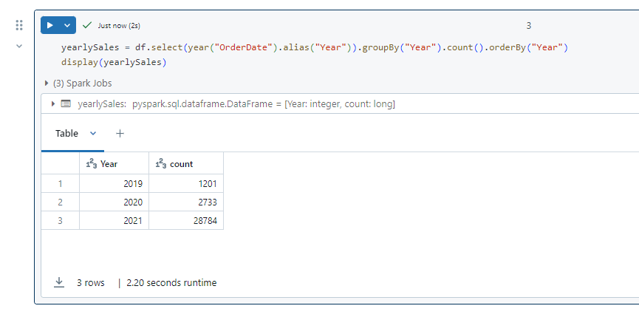

Slide 9
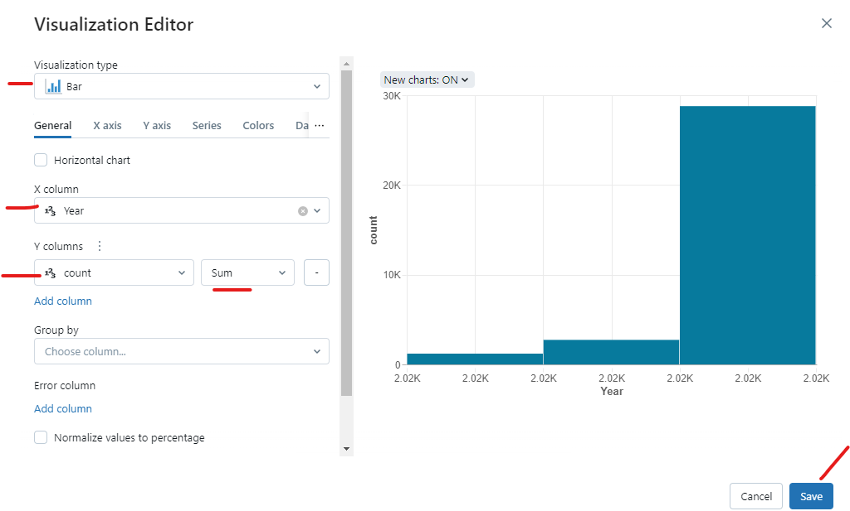

Slide 10
Build the Workflow
Azure Databricks manages the task orchestration, cluster management, monitoring, and error reporting for all of your jobs. You can run your jobs immediately, periodically through an easy-to-use scheduling system, whenever new files arrive in an external location, or continuously to ensure an instance of the job is always running.

Slide 11
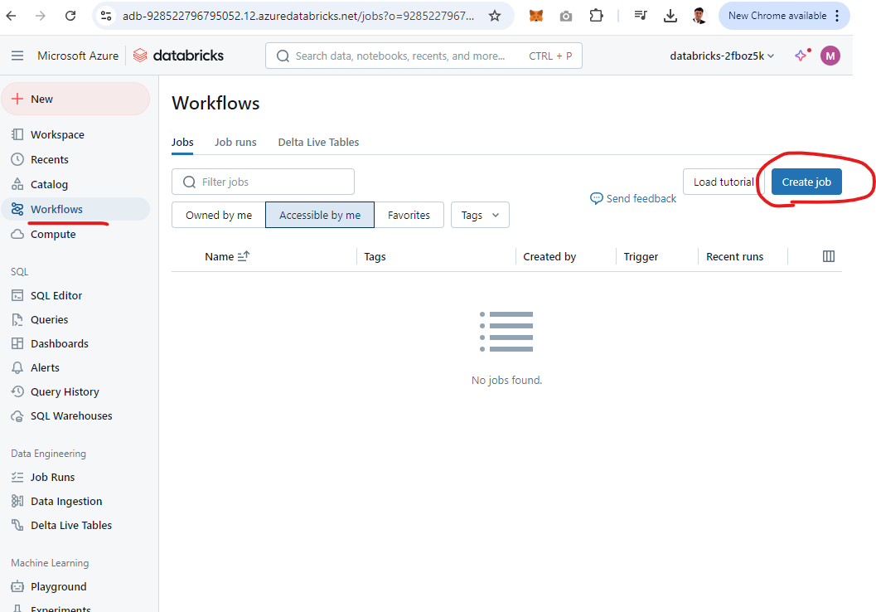

Slide 12
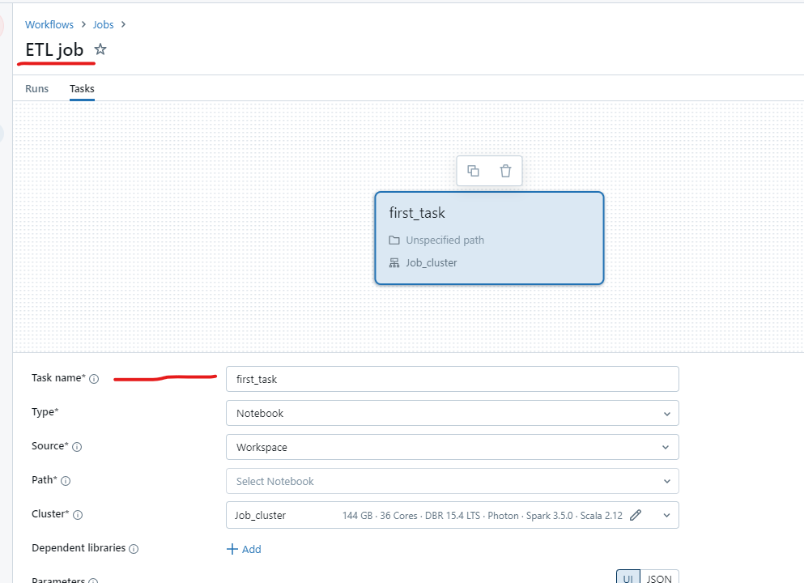

Slide 13
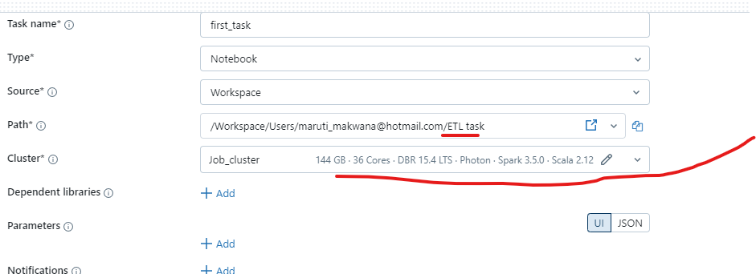
Choose
According to your subscription

Slide 14
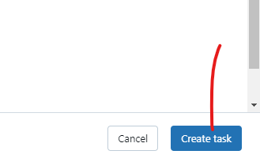
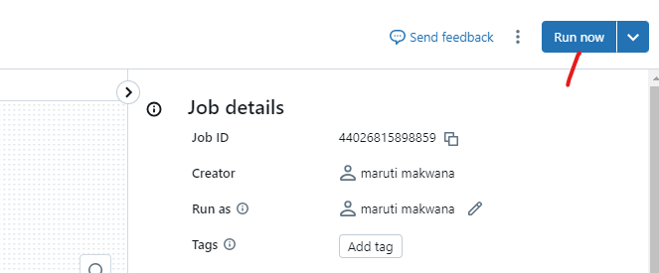

Slide 15
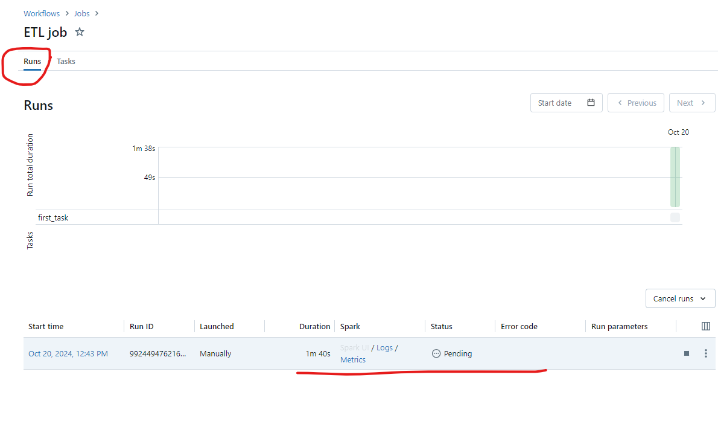

Slide 16
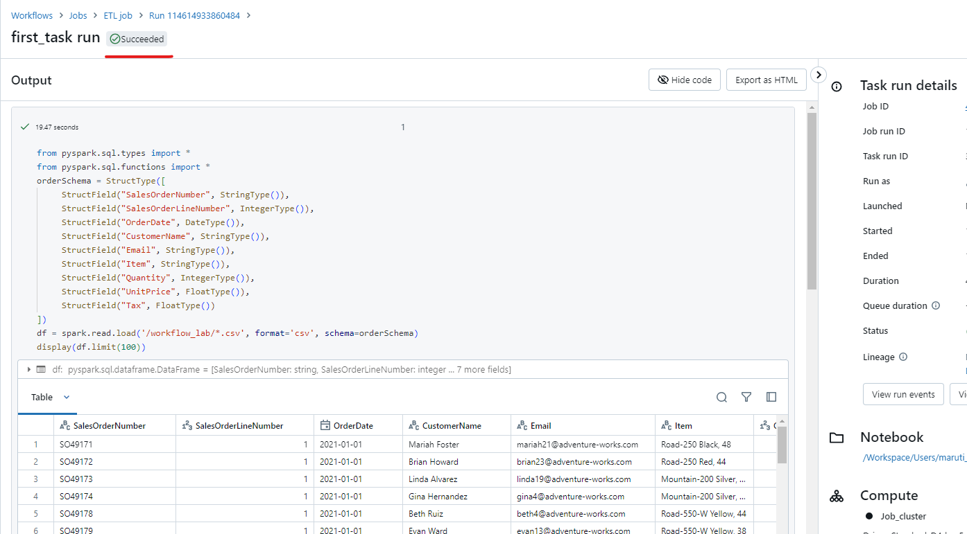

Slide 17
End-to-End Streaming Pipeline with Delta Live Tables in Azure Databricks

Slide 18
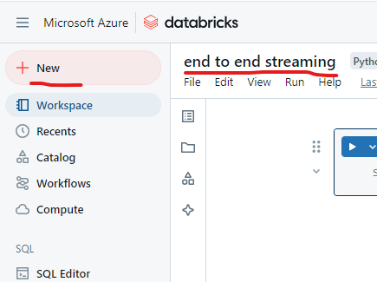

Slide 19
Use delta tables for streaming data
Delta lake supports streaming data. Delta tables can be a sink or a source for data streams created using the Spark Structured Streaming API. In this example, you’ll use a delta table as a sink for some streaming data in a simulated internet of things (IoT) scenario. In the next task, this delta table will work as a source for data transformation in real time.

Slide 20
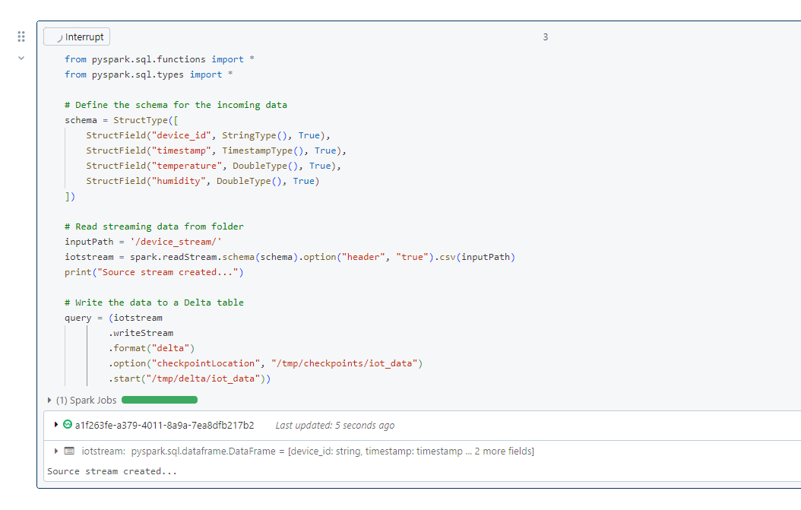

Slide 21
This delta table will now become the source for data transformation in real time.

Slide 22
Create a Delta Live Table Pipeline
A pipeline is the main unit for configuring and running data processing workflows with Delta Live Tables. It links data sources to target datasets through a Directed Acyclic Graph (DAG) declared in Python or SQL.

Slide 23
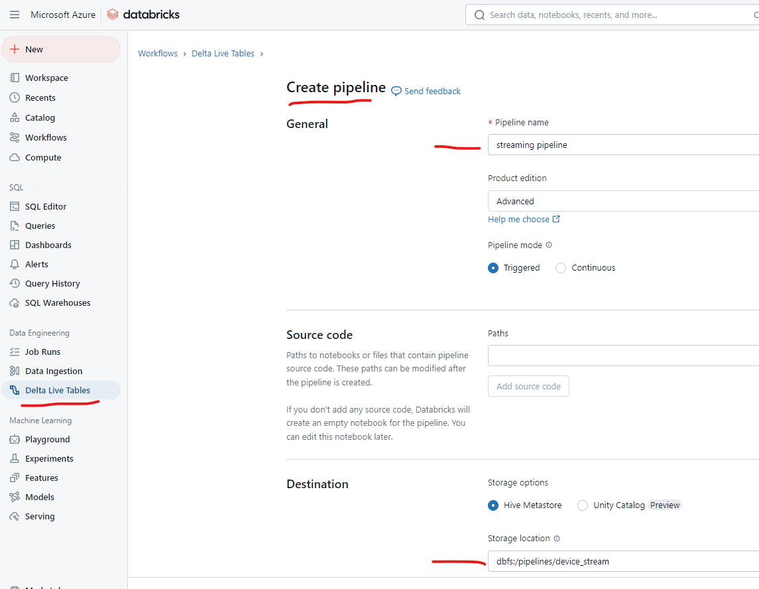

Slide 24
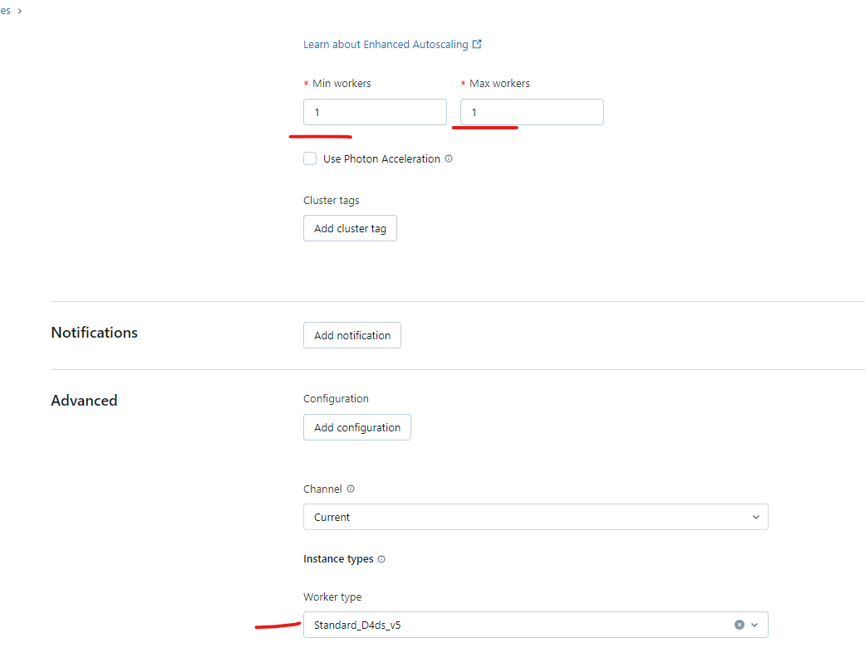

Slide 25
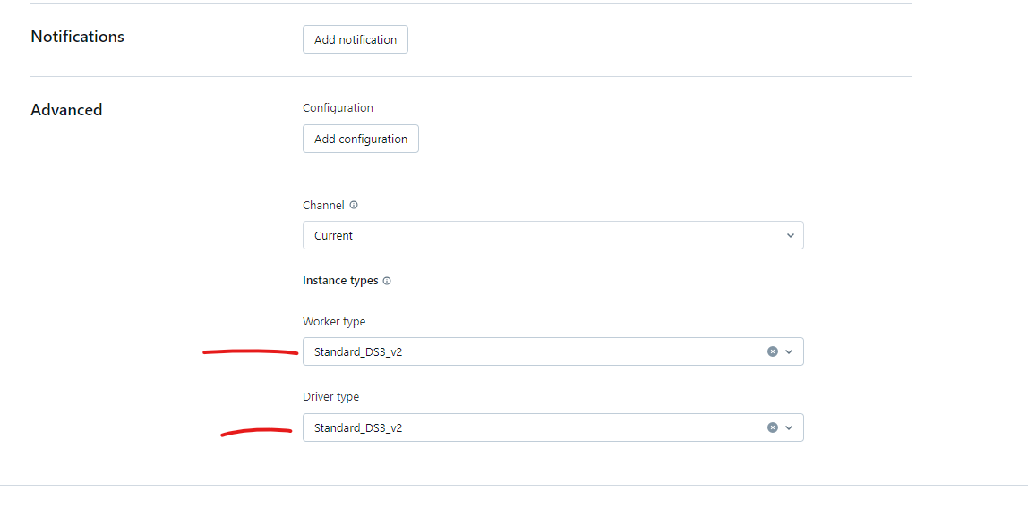
If above is not working then try to change worker and driver type like this

Slide 26
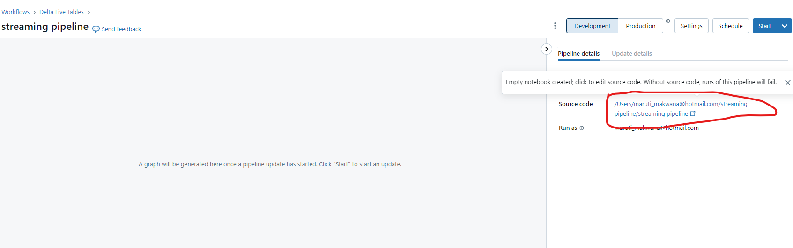
Once the pipeline is created, open the link to the blank notebook under Source code in the right-side panel:

Slide 27
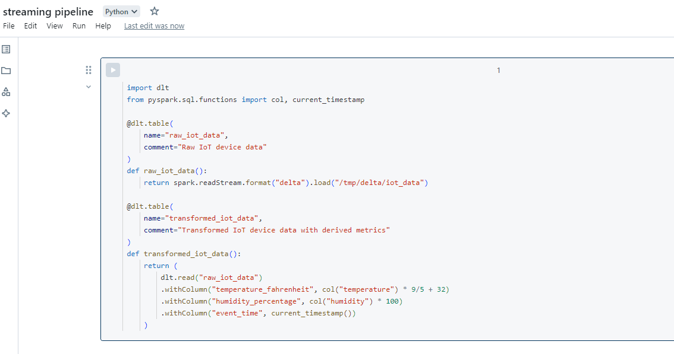
In the first cell of the notebook, enter the following code to create Delta Live Tables and transform the data:

Slide 28
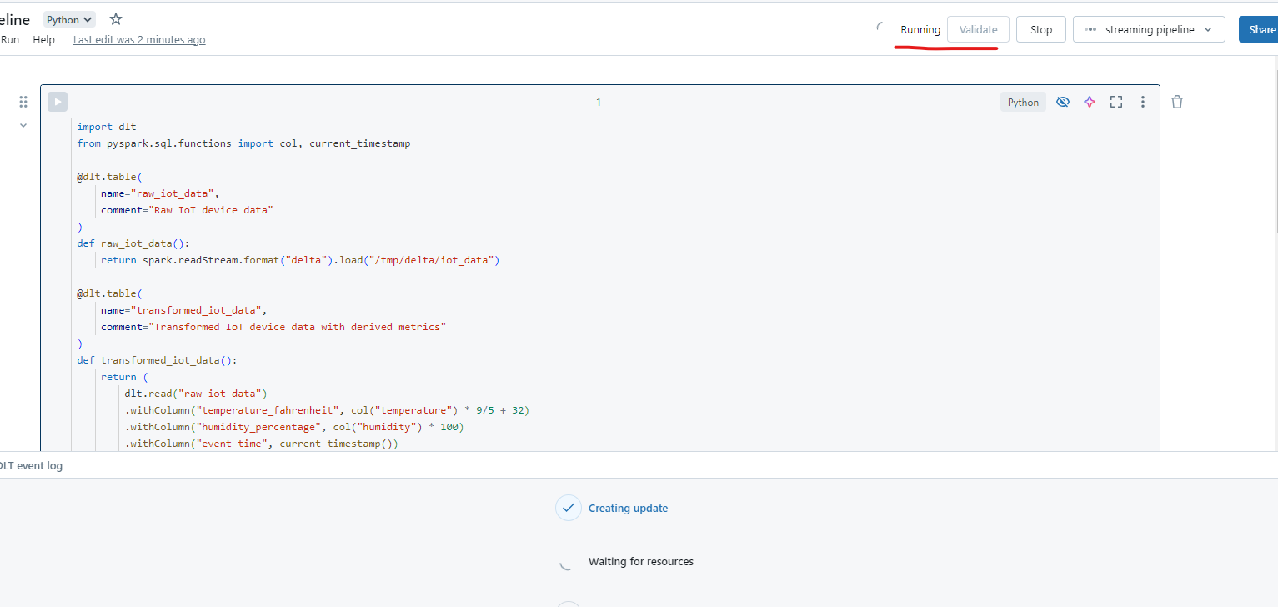
START this pipeline

Slide 29
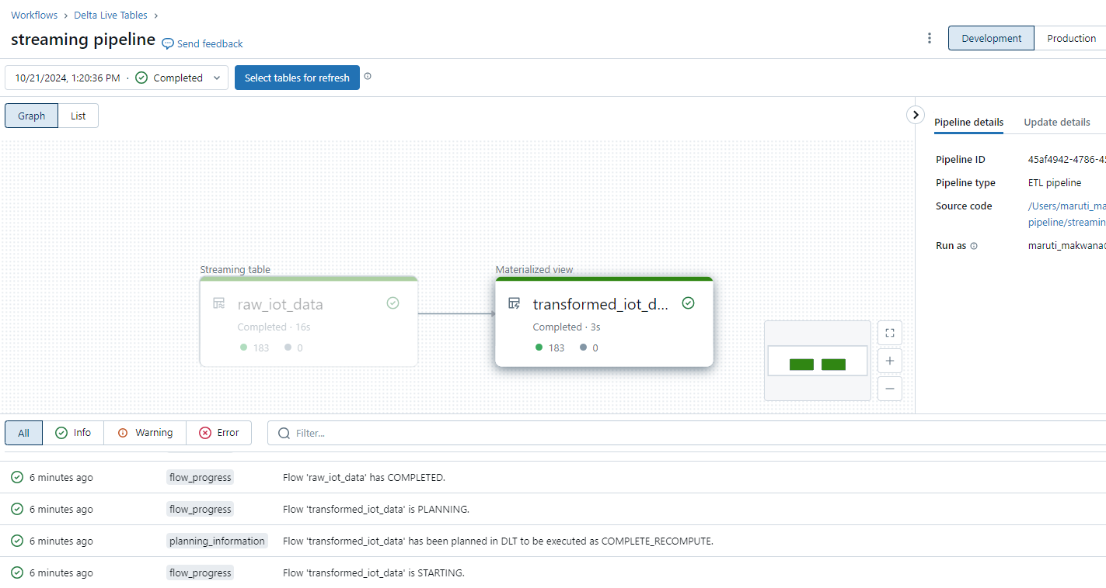

Slide 30
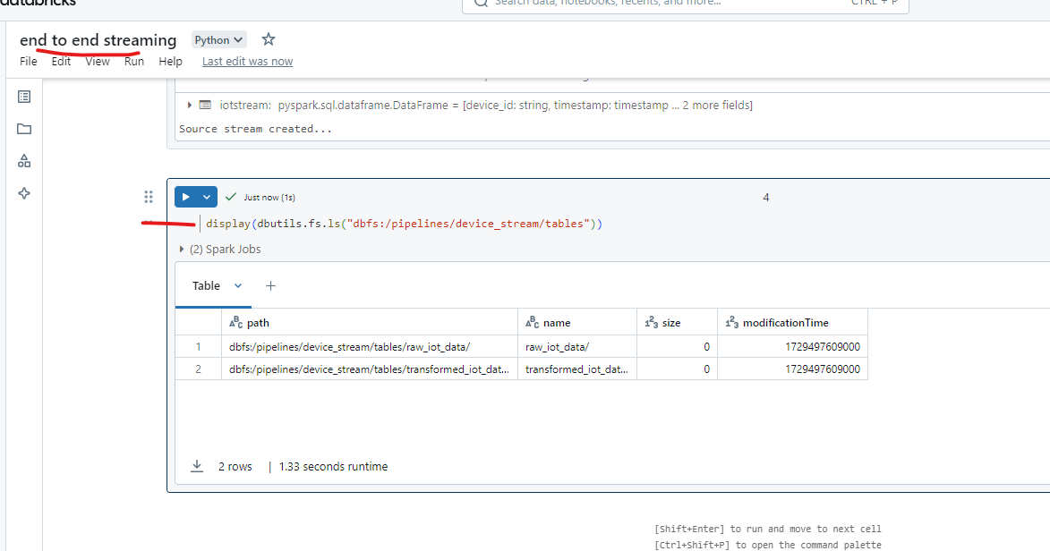
Once the pipeline is successfully executed, go back to the first notebook and verify that the new tables have been created in the specified storage location with the following code:

Slide 31
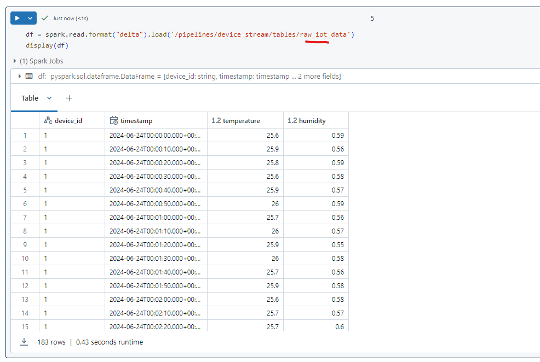

Slide 32
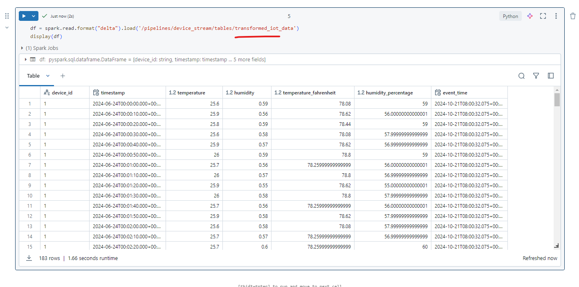
View results as a visualization

Slide 33
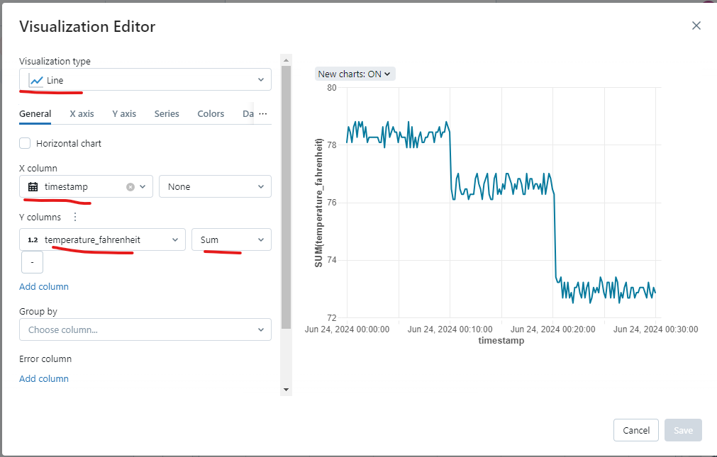

Slide 34
Optimize Data Pipelines for Better Performance in Azure Databricks
https://microsoftlearning.github.io/mslearn-databricks/Instructions/Exercises/DE-03-Optimize-data-pipelines.html

